Slide 1
Reinforcement Learning Part 2

Slide 2
Outline
What makes Reinforcement Learning difficult
How to measure effectiveness
Procgen
Proximal Policy Optimization

Slide 3
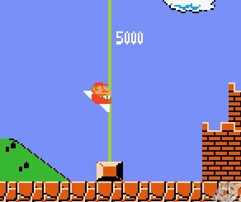
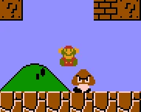

Level 1
Challenges
Memorization
Training a model on limited information (e.g. one level of the game) can create deceptive performance estimates
Generalization might not occur even if objective function is well explored
Randomness
Randomness can both help (during exploration) and hurt (slowing down learning) reinforcement learning algorithm
Observability
Previously, the state was fully observable
In real applications, it might not be the case
Rewards shaping
The value function can usually be defined in multiple ways
Each way can affect the learning and, ultimately, the success of RL implementation.
Level 2
Level 3

Slide 4
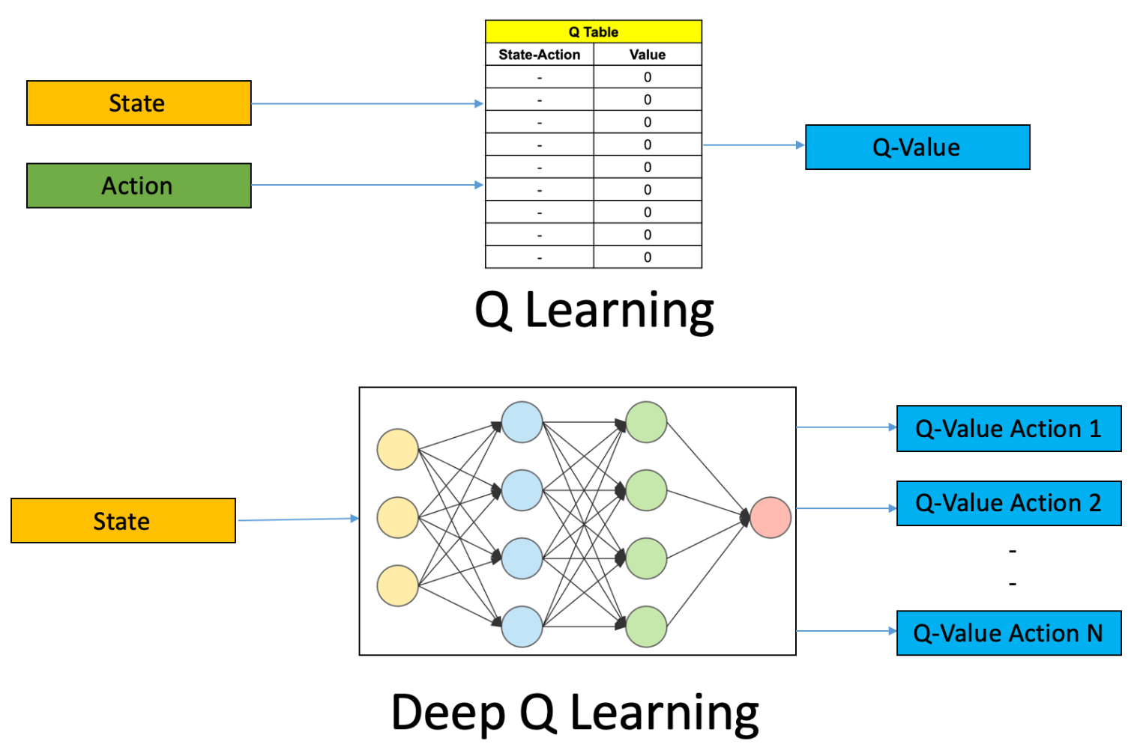
Measures of Effectiveness
Several factors affect payoff of value function
Gameplay mechanics (e.g. dimensionality of state and action space)
Gameplay difficulty
Randomness (deterministic vs. stochastic value function)
Based on the final shape of value function, several methods can be applied:
Backwards induction/Envelope method if value function is known and well behaved (e.g. differentiable)
Estimating a neural net if value of the function is unknown

Slide 5
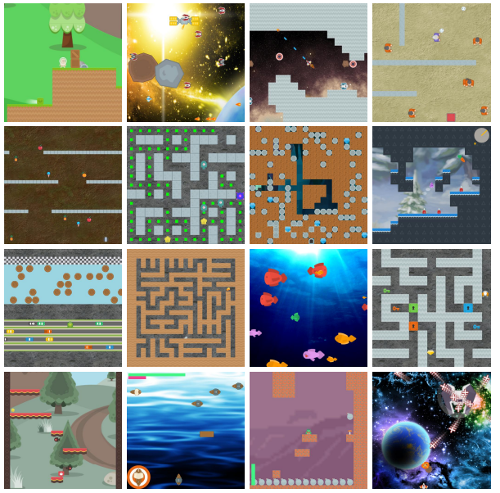
Introduction to Procgen
Procedural generation
The data or the content is generated via a certain logic/algorithm, instead of a human creating the content manually.
Replayability is endless (never get the same level)
Procgen
16 unique environments designed to measure both sample efficiency and generalization in reinforcement learning
Procedurally generated levels with 99% solvability
Different difficulty levels

Slide 6
Proximal Policy Optimization
Despite being the most popular RL method, Q-learning have several problems:
Poor performance on continuous control benchmarks
Poor interpretation
Proximal Policy Optimization attempts to solve these problems
By using first order optimizations (gradients), making algorithm more computationally efficient.
By introducing clipped objective, i.e. to avoid excessively large policy updates.

